Slide 1
Docker Hub 使用
2019
組員: 蔡昀霖 糠依婷
2019/3/7

Slide 2
1
Docker Hub 註冊
目錄
2
Docker Hub 設定
3
Portainer 設定

Slide 3
Docker Hub 註冊
01

Slide 4
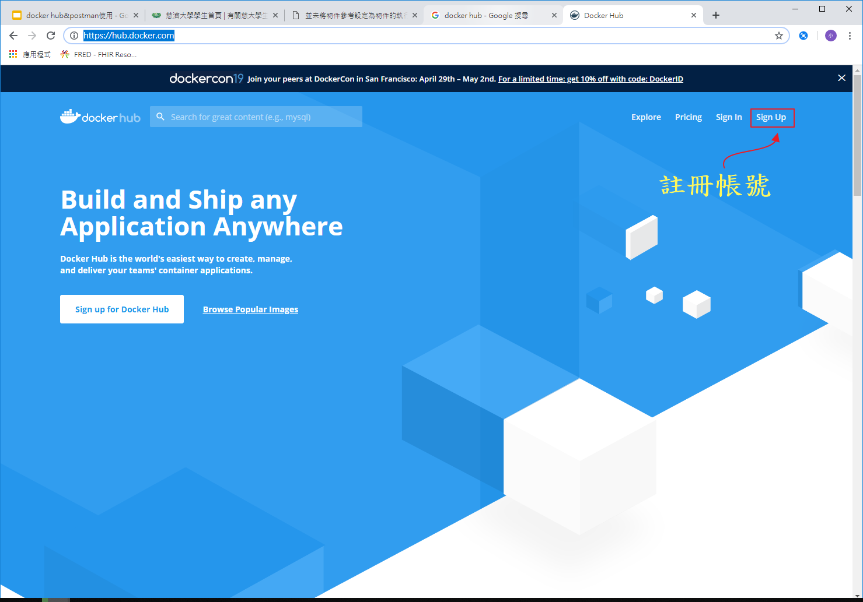
https://hub.docker.com/

Slide 5
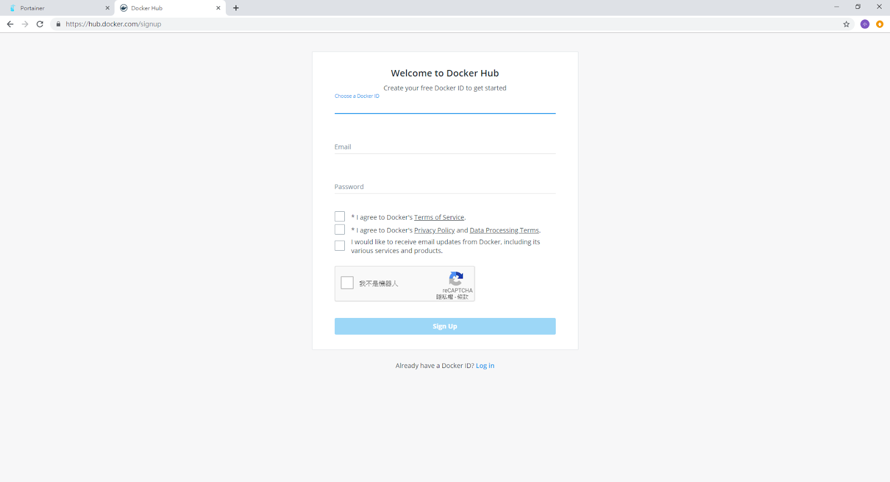
Docker Hub註冊

Slide 7
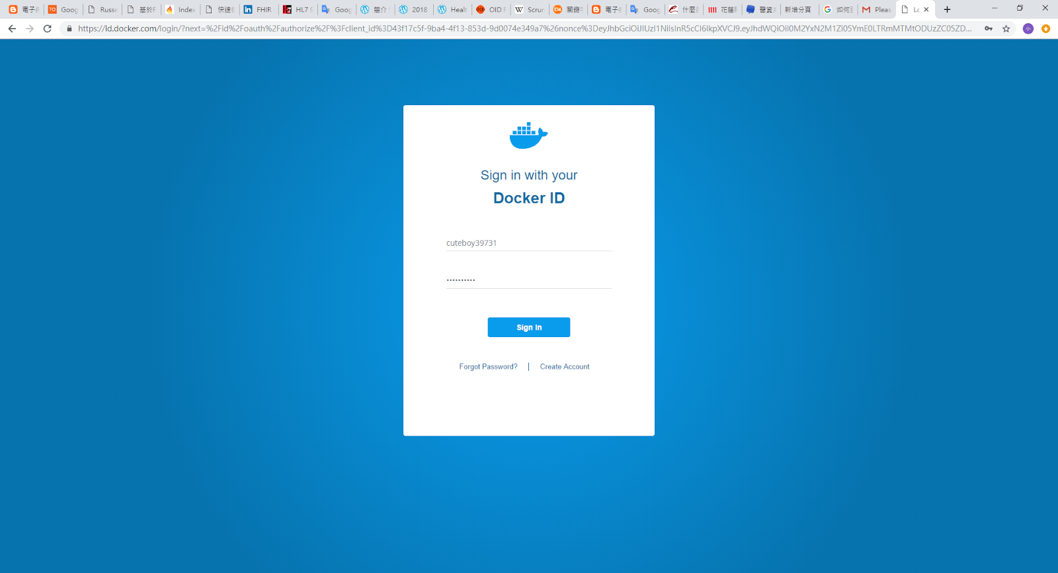
Docker Hub登入

Slide 8
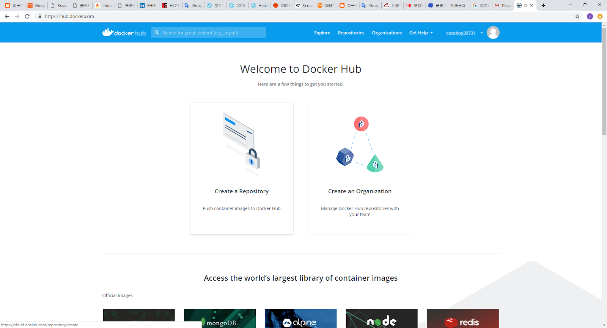
註冊成功

Slide 9
Docker Hub設定
02

Slide 10
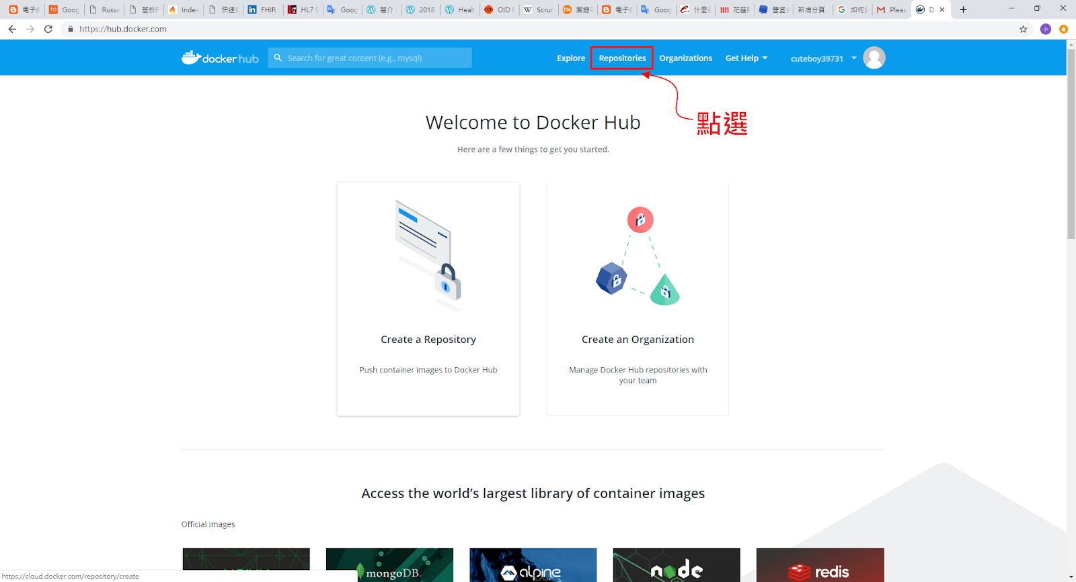
Docker Hub設定

Slide 11
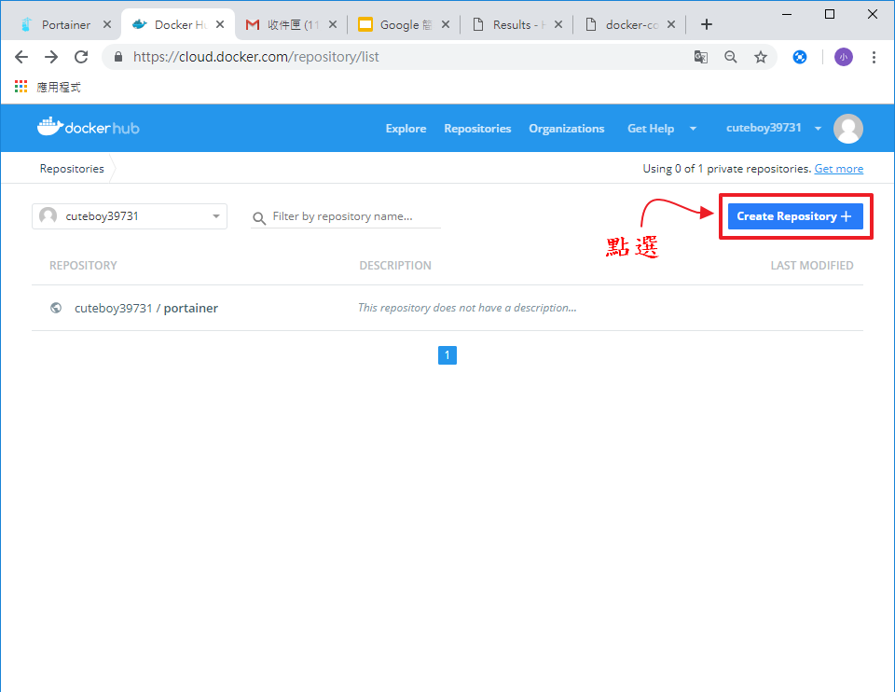

Slide 12
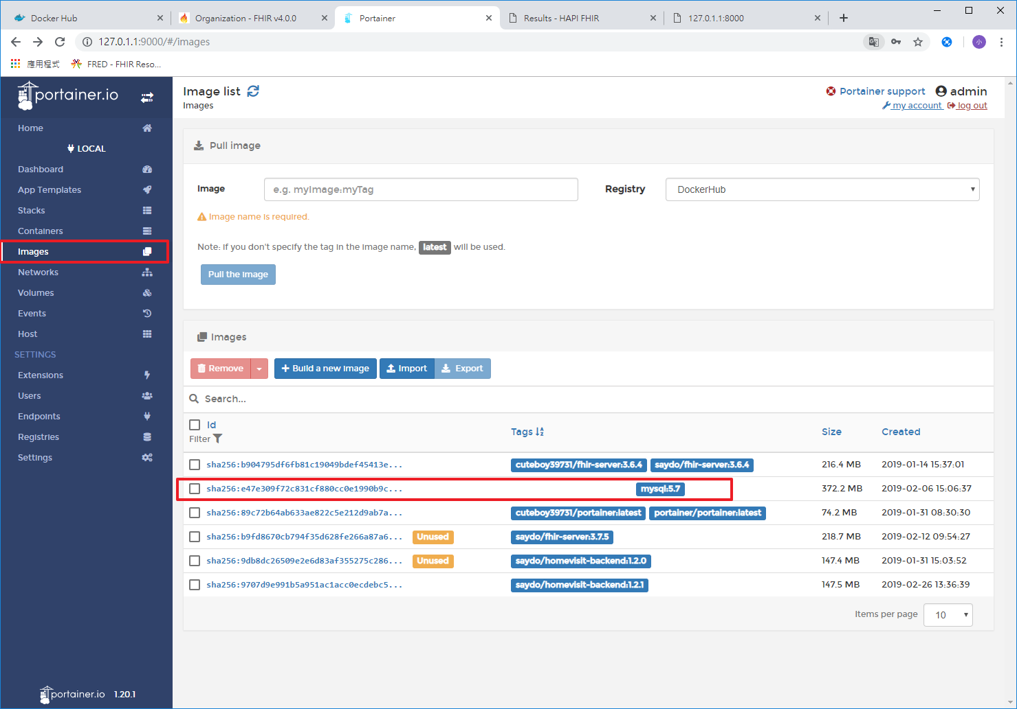
到Portainer選取要上傳的image

Slide 13
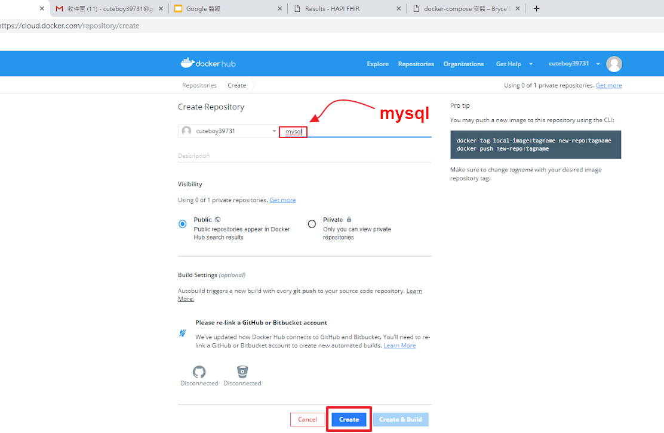
輸入image tags名稱

Slide 14
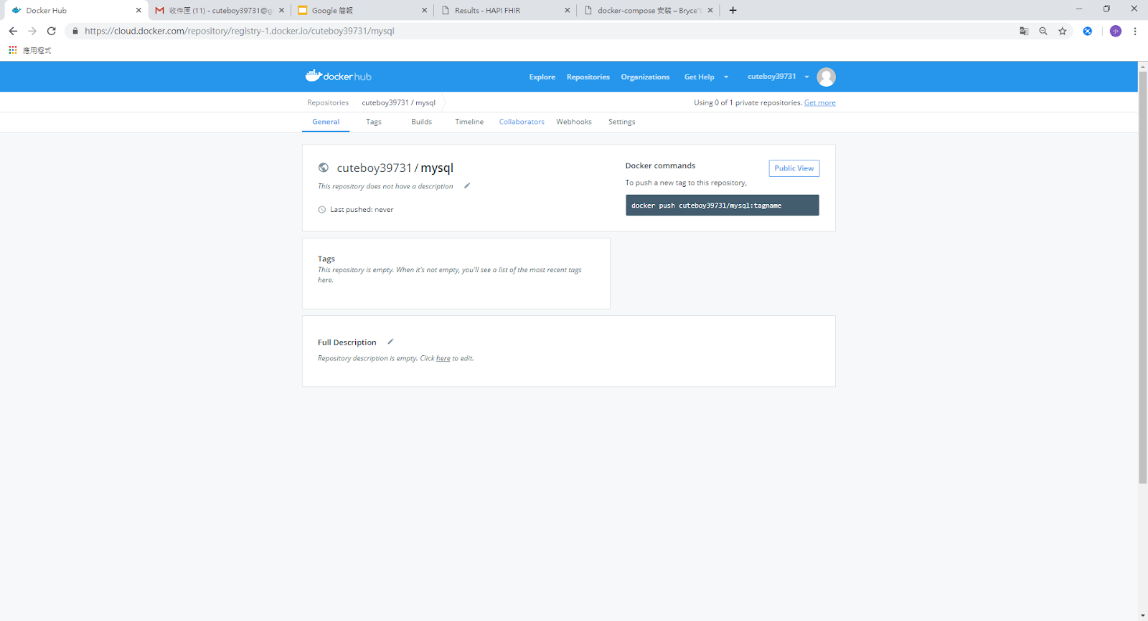

Slide 15
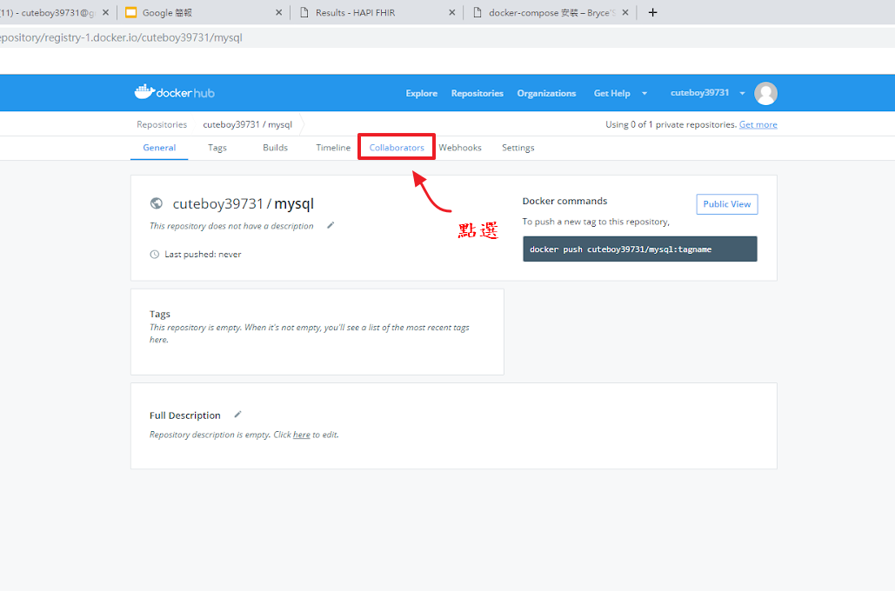

Slide 16
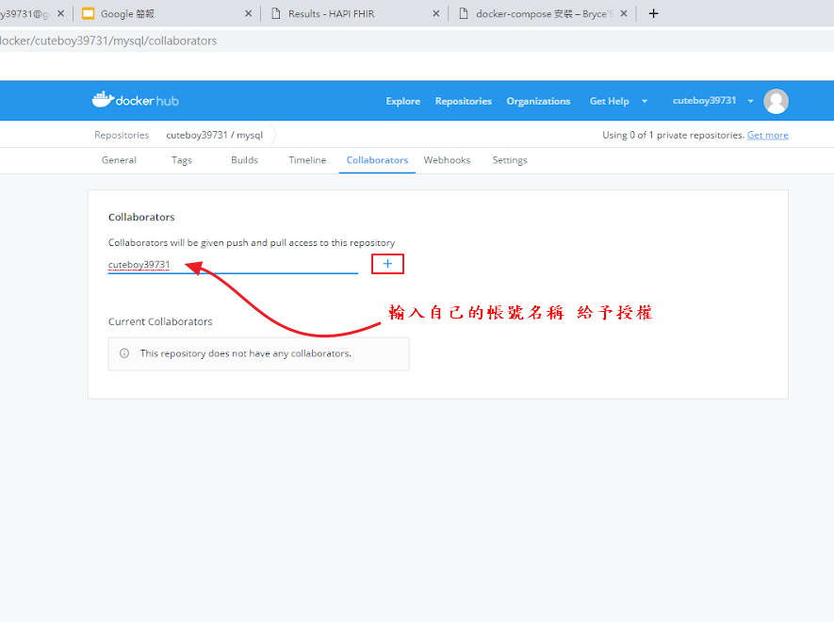

Slide 17
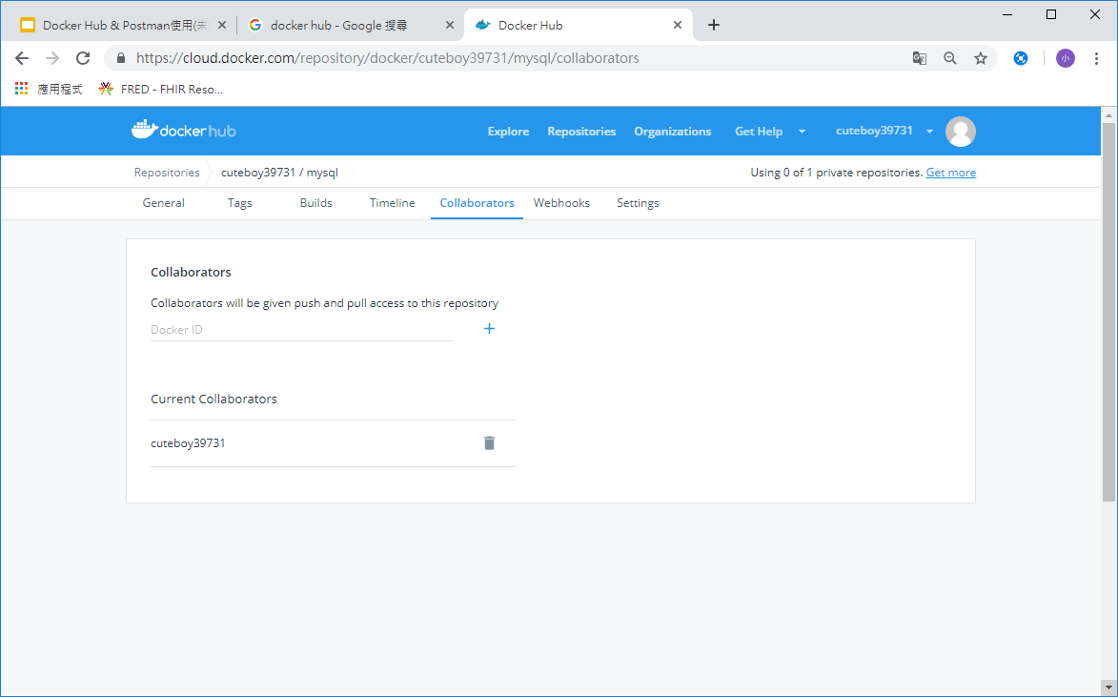

Slide 18
Portainer設定
03

Slide 19
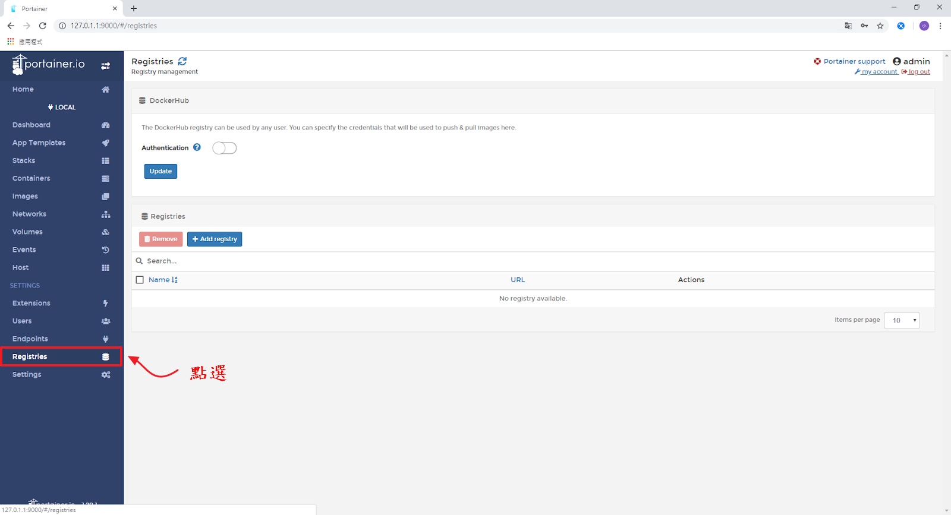
開啟Portainer

Slide 20
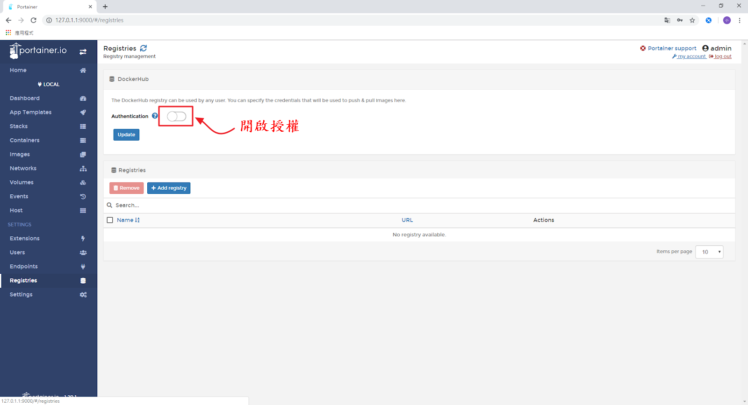

Slide 21
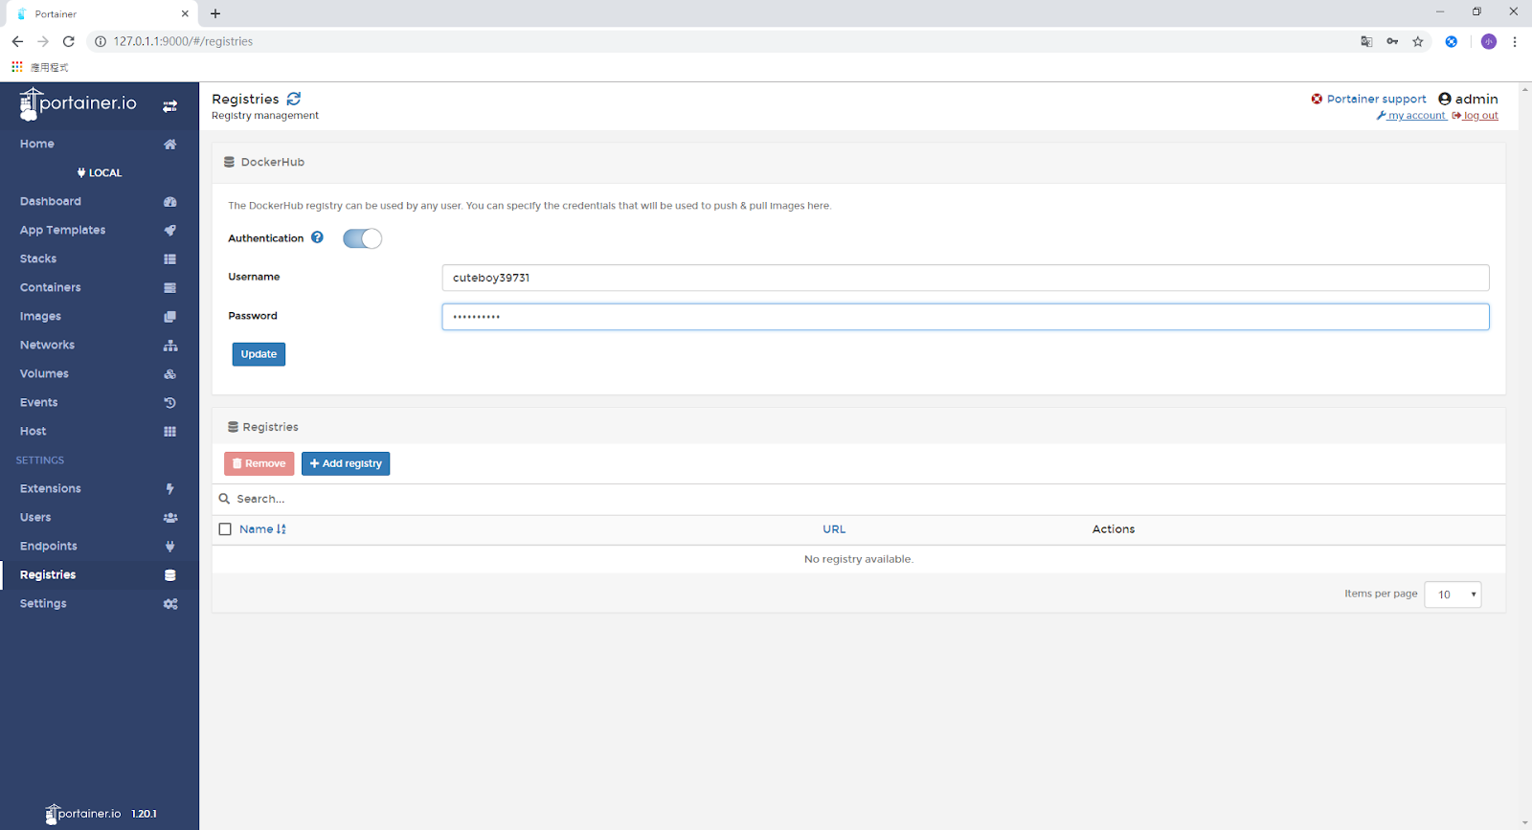
輸入Docker hub帳號&密碼

Slide 22
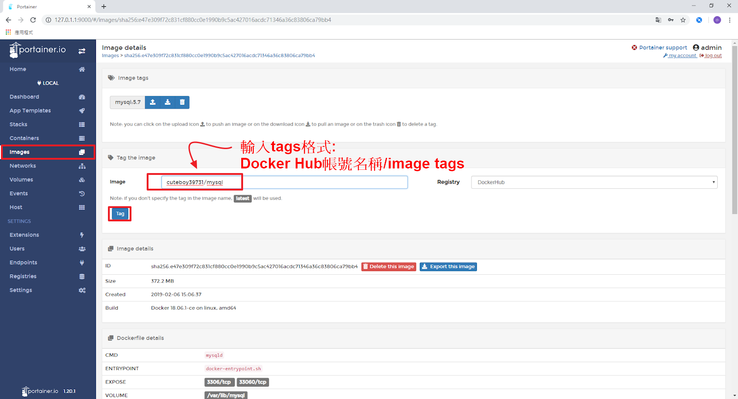

Slide 23
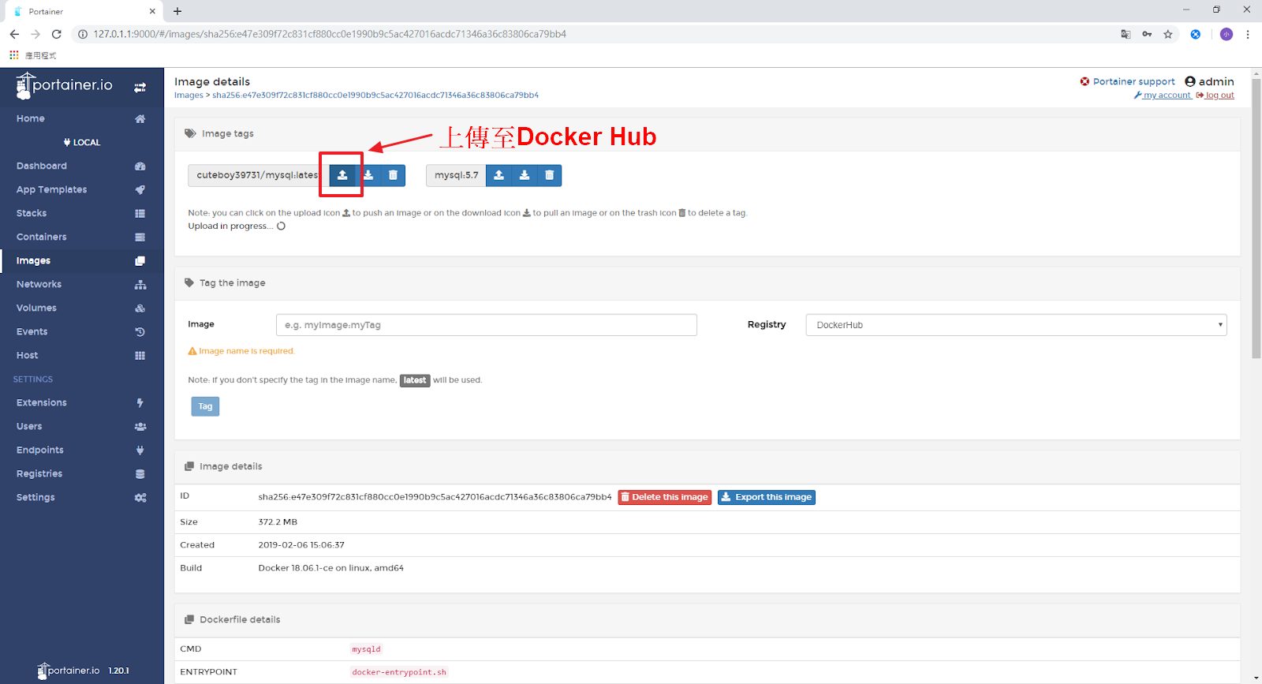

Slide 24
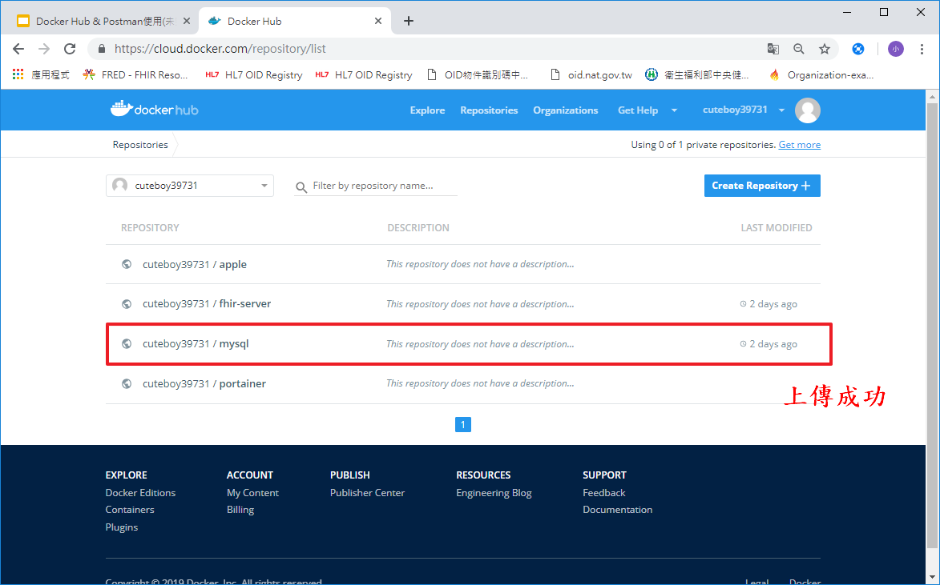

Slide 25
END
Notes:
本素材由iSlide 提供
iSlide 尊重知识产权并注重保护用户享有的各项权利。郑重提醒您：
iSlide 插件中提供的任何信息内容的所有权、知识产权归其原始权利人或权利受让人所有，您免费/购买获得的是信息内容的使用权，并受下述条款的约束；
1. 您仅可以个人非商业用途使用该等信息内容，不可将信息内容的全部或部分用于出售，或以出租、出借、转让、分销、发布等其他任何方式供他人使用；
2. 禁止在接入互联网或移动互联网的任何网站、平台、应用或程序上以任何方式为他人提供iSlide 插件资源内容的下载。
The resource is supplied by iSlide .
iSlide respects all intellectual property rights and protects all the rights its users acquired. Solemnly remind you:
The ownership and intellectual property of the resources supplied in iSlide Add-in belongs to its owner or the assignee of this ownership. you only acquired the usage of the resources supplied in iSlide Add-in, as well as respected the following restrain terms:
1.You are only allowed to use such resource for personal and non-commercial aim, not allowed to use such resource or part of it for the sale; or rent, lend, transfer to others; or distribution or release it in any way.
2.You are not permitted to provide the resource of iSlide Add-in in any website, platform, application access to the Internet or mobile Internet.

